Slide 1
WEB PHISHING DETECTION LITERATURE SURVEY
Team
VAKA VASANTHA
VAKA RESHMA
NARALA PRAVEENA
RAVULAPALLI LAKSHIMI SUSMITHA
Department of Computer Science and Engineering

Slide 2
ABSTRACT Phishing is a fraudulent technique that is used over the Internet to deceive users with the goal of extracting their personal information such as username, passwords, credit card, and bank account information. The key to phishing is deception. Phishing uses email spoofing as its initial medium for deceptive communication followed by spoofed websites to obtain the needed information from the victims. Phishing was discovered in 1996, and today, it is one of the most severe cybercrimes faced by the Internet users. Researchers are working on the prevention, detection, and education of phishing attacks, but to date, there is no complete and accurate solution for thwarting them. This paper studies, analyzes, and classifies the most significant and novel strategies proposed in the area of phished website detection, and outlines their advantages and drawbacks. Furthermore, a detailed analysis of the latest schemes proposed by researchers in various subcategories is provided. The paper identifies advantages, drawbacks, and research gaps in the area of phishing website detection that can be worked upon in future research and developments. The analysis given in this paper will help academia and industries to identify the best anti-phishing technique.

Slide 3
INTRODUCTION TO WEB PHISHING Web phishing attacks Phishing is a fraudulent act that is used to deceive users over the Internet with the goal of obtaining their personal information. The attackers who plan phishing attacks are commonly termed as phishers. Phishing became a serious cyber threat in 1996 when phishers stole the user names and passwords of AOL users. In most cases, a successful phishing attack is accomplished using email spoofing and website spoofing techniques. Phishing starts with attackers sending spoofed emails to target victims over the Internet and making their communication look as though it is coming from authentic entities such as banks, credit card companies, and government agencies . The email addresses are spoofed as their source addresses are made to look similar to that of an email coming from an authentic source. For example, if a bank manager of bank “xyz” has the email address: bankmanager@xyz.co.in, then the attacker will try to spoof his email with the address bankmanager@xyz.co.in so that the user believes in the authenticity of the email and performs the steps asked by the phisher. The actions requested in the email are typically opening web links and providing their identity or banking information either on the web or as a reply to the email. Open SMTP (Simple Mail Transfer Protocol) servers are utilized for email spoofing, which allows attackers to send spoofed emails to victims. As many users do not reveal their personal information in reply to an email, another deceptive tactic is implemented by creating phished websites that are identical or very similar in their look and feel to the targeted authentic websites .

Slide 4
Once the user clicks the web link provided in the spoofed email, he is directed to the phished website created by the phisher. As this phished website looks similar to the original website, a novice user often fails Phishing is a fraudulent act that is used to deceive users to identify it as malicious and enters the requested information, resulting in a successful phishing attempt
Phished emails
Phished websites
successful
phishing

Slide 5
Apart from emails, attackers can lead users to malicious links by publicizing them as advertisement links on authentic websites. Furthermore, in some cases, an infected DNS can result in user redirection to abnormal and phished websites. Other well-known ways used by phishers for carrying out web phishing attacks are as follows: (1) Phisher creates informational websites that provide valuable information to the user. These websites also provide links to connect to Facebook, Gmail, and Twitter. These links redirect the user to phished websites instead of the authentic websites. To maintain the user’s confidence in deceptive links, phishers generally use link manipulation techniques. (2) In a covert phishing attack, a compromised real website can be used by an attacker to create a login pop up asking for a user’s personal information . (3) A compromised DNS may be used by phishers to redirect the user’s request for benign URLs to their phished ones. (3) A compromised DNS may be used by phishers to redirect the user’s request for benign URLs to their phished ones.

Slide 6
A practical phishing scenario: A practical phishing uses spoofed email communication. The steps followed by a phisher for a typical phishing attempt are as follows: (1) Phisher runs a spoofed version of the targeted website over a web server and sends spoofed emails to the target users. (2) The email generally contains a message stating an emergency which requires immediate action. For example, it may ask the user to login into his bank account and provide some information, failing which his bank account will be closed. (3) The spurious link in the email directs the user to the web server on which the phisher has hosted the similar looking login page of the targeted website. (4) The user supplies his credentials on the spoofed website, which is then stored by the phisher. (5) This user’s information is then utilized by the phisher to carry out fraud such as using credit card information for online purchases or for carrying out fraudulent transactions using the user’s bank credentials.

Slide 7
Web phishing tactics : A special form of phishing known as spear phishing targets a specific individual or a specific company . When phishing targets high-profile users, it is termed as Whaling . A variant of phishing is Tab nabbing wherein a tab switch performed by the user is used by the malicious websites to load a phishing webpage. When the user switches back the tab, assuming that it as an authentic website left opened by him or her, the user enters his or her credentials to this phishing webpage. Phishing uses deception techniques for its success. shows major deception techniques used by phishers. Advanced Internet fraud techniques such as email spoofing, website spoofing, and exploitation of browser and web technology vulnerabilities are used to deceive/lure/redirect the targeted users to a phished website. Phishers use various tricks to carry out a successful deception. These tricks include the following: (i) link manipulation (the contents of < A > tag content are made to display a web link going to an authentic URL, where as in the background it actually goes to a phished or malicious URL); (ii) evading phishing detection filters (with the use of images instead of text that can remain undetected by many phishing filters );

Slide 8
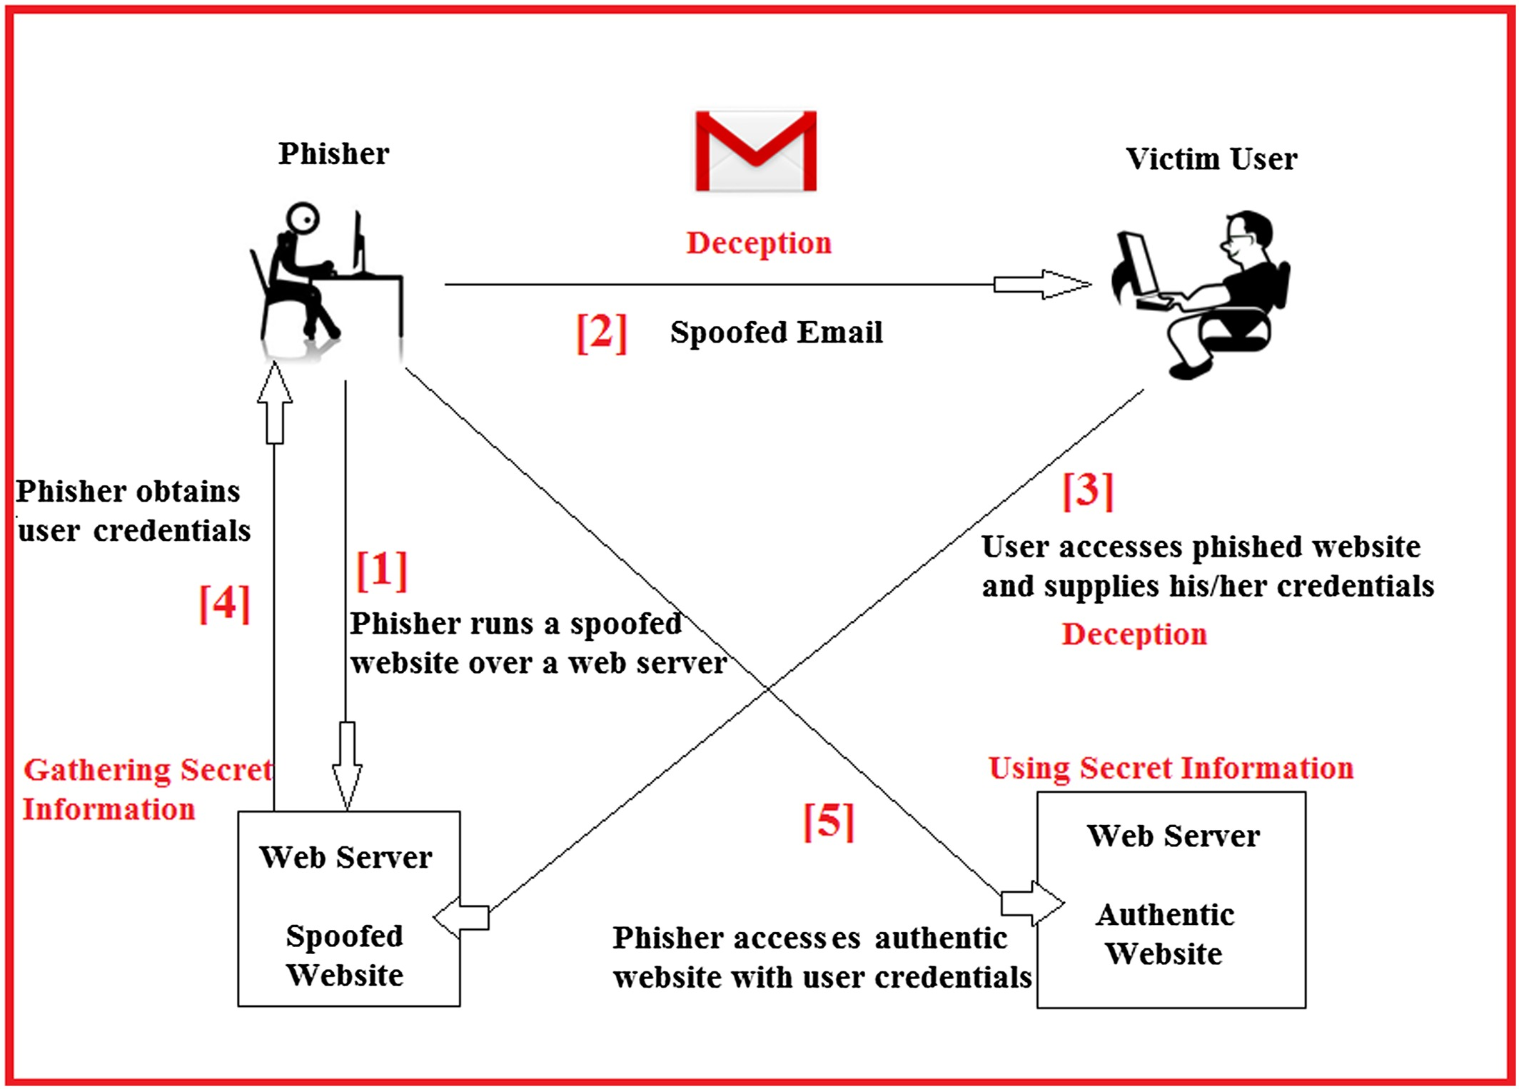
h

Slide 9
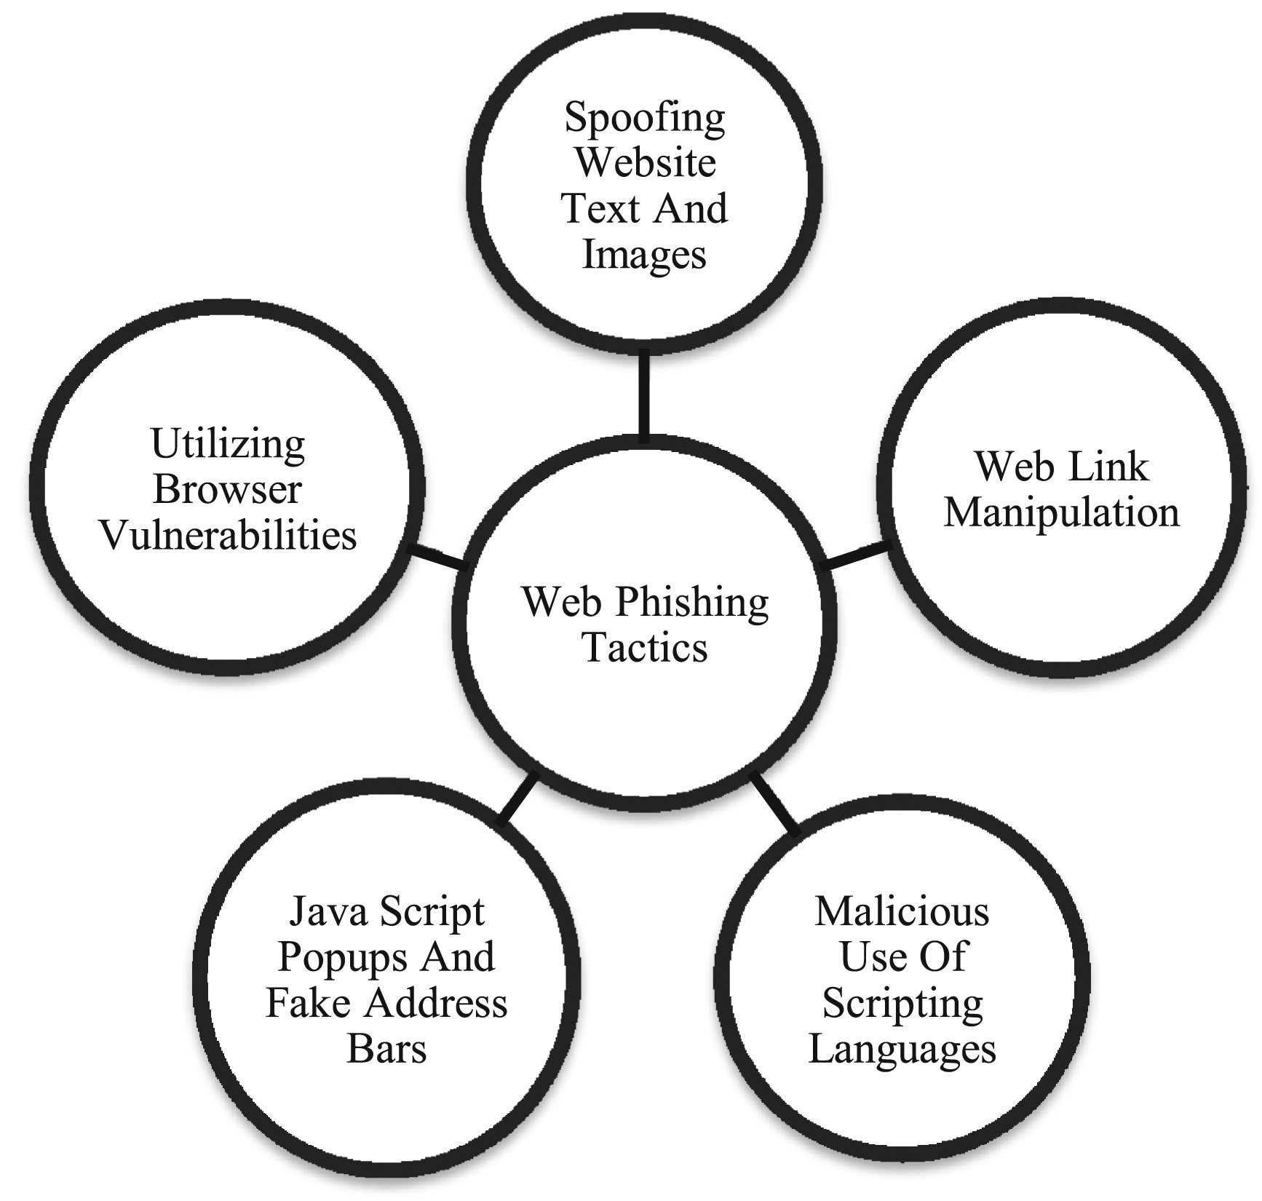
(iii) malicious use of web scripting languages (using Java script to hide browser address bar and create a custom address bar displaying a hard coded authentic URL to the user); (iv) using pop-up windows to ask user names and passwords; and utilizing browser vulnerabilities

Slide 10
Current phishing statistics : Starting from 1996 to the date of writing this paper, there have been a significant number of phishing attacks recorded and analyzed by anti-phishing organizations such as APWG and Phishtank. According to the APWG Phishing Trends Report, 158,544 unique phishing websites were recorded in the fourth quarter of 2015. In most of the cases, financial and online payment companies were targeted, and the majority of these phishing websites are hosted on a server located in the USA. Table I.I describes the current trends (first Quarter 2014 to fourth Quarter of 2015) of phishing attacks in terms of “Number of Phishing Websites,” “Number of Phishing Emails,” “Top Country Hosting Phishing Sites,” “Most Affected Services,” and “Most Targeted Top Level Domain (TLD).” As demonstrated by Table I.I there is no significant decrease in the number of phishing incidents, despite various phishing detection and prevention schemes proposed by researchers. Hence, there is an immense need for research and development on security solutions to prevent or detect phishing attacks over the Internet and to safeguard novice users and online transactions

Slide 11
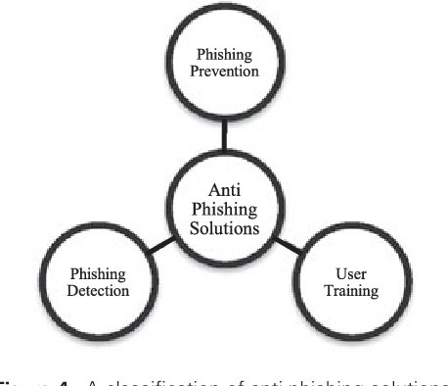
Anti-phishing solutions : There has been a great deal of research in the area of phishing prevention and detection. The proposed solutions include training users on phishing-related activities; phishing detection and prevention; use of anti-phishing software; browser extensions and toolbars [23]; DNS and WhoIs information of URLs; new measures of user authentication; filtering phishing emails [24] and websites; real time, proactive detection, monitoring and shutting down of phishing websites; two factor authentication schemes; disabling malicious Java scripts; secure browser developments; and so on. Anti-phishing solutions can be majorly categorized as phishing prevention solutions, user training solutions, and phishing detection solution. Phishing is a fraudulent act that is used to deceive users

Slide 12
Phishing prevention schemes: Phishing prevention schemes try to prevent phishing attacks by providing an extra layer of security to the authentication schemes and user interaction platforms (via two factor authentication and two-way authentication). This reduces the probability of a user being deceived by an attacker’s phishing website. Phishing prevention techniques can be further classified as watermarking based [25], RFID based [26], external authentication devices based [27], picture password based [28], dynamic security skin based [18,29], smart card based [30], and QR Code based techniques [31], and so on. [12]. These techniques can prevent most phishing attacks, but they require changes and support on the website’s side and cooperation and understanding on the user’s side for their success. Furthermore, these solutions may lead to complex user interfaces, may incur extra cost for the computation of each authentication, and may also require users to keep extra authentication devices, making it cumbersome to implement and use.

Slide 13
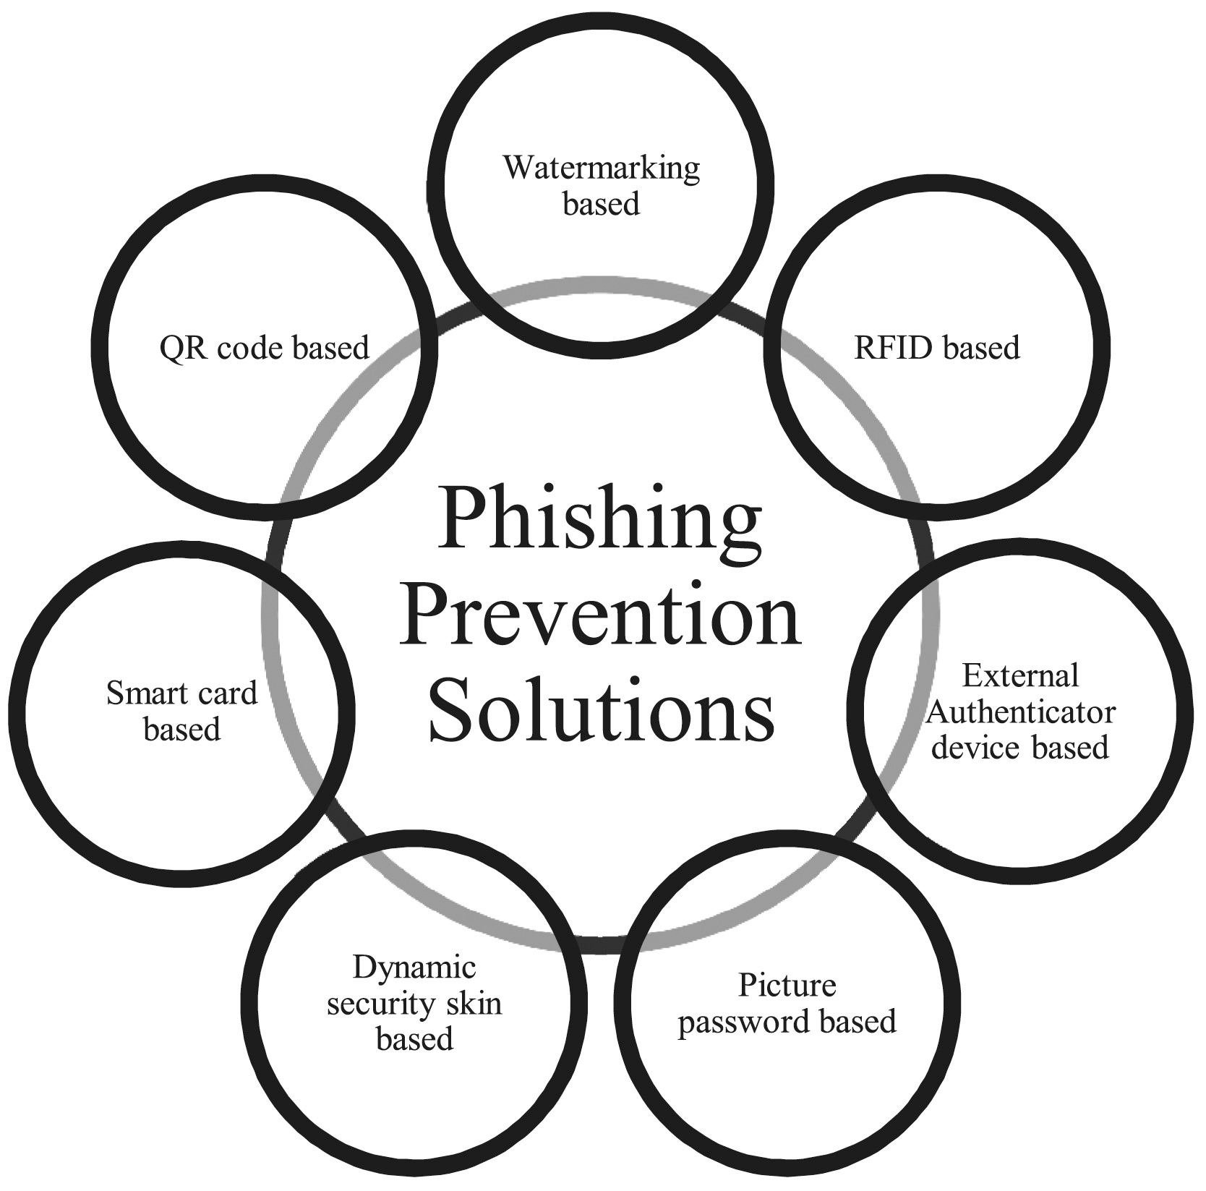
a

Slide 14
User training schemes: User training schemes try to educate users through emails and other mediums so that users themselves can identify phishing attempts targeted at them. Although the idea is good, it does not provide a fool-proof solution, as a large population of users are novice who may not understand how SSL, certificates, and URLs of the websites can be checked for their authenticity, even after training. Therefore, a complete reliance on such ineffective solutions can be disastrous. Phishing detection schemes: Phishing detection schemes [38–45] that detect a phishing website, either through a web browser on the client side or via specific software at the host, or solutions that detect phishing at the server side are better than phishing prevention and user training schemes. This is because they have a minimal reliance on novice Internet users. When a website is detected as a phishing or probable phishing website, access to the website is blocked or the user is notified that the website may not be authentic. This method required minimal user training and does not require any changes to the existing authentication schemes used by a website. The accuracy of the detection schemes is measured in terms of the following parameters:

Slide 15
• Number of True Positives (TP): The number of phishing websites correctly labeled as phishing. • Number of True Negatives (TN): The number of legitimate websites correctly labeled as legitimate. • Number of False Positives (FP): The number of legitimate websites incorrectly labeled as phishing. • Number of False Negatives (FN): The number of phishing websites incorrectly labeled as legitimate. The accuracy of phishing detection schemes is normally evaluated using a set of benchmark datasets. The popular normal dataset and phishing dataset are given as follows: I. Normal Dataset Alexa Dataset : Alexa dataset is used as a benchmark dataset of benign and normal websites. Alexa is a commercial company that performs the task of web traffic data analytics over the web. It obtains users’ browsing patterns from various sources and critically analyzes them for web traffic reporting and ranking of URLs on the Internet. The rankings provided by Alexa are used by researchers to accumulate a set of highly ranked websites as a normal dataset for testing and identifying TNR. Alexa provides the dataset of normal websites in the form of a raw text file in which each line mentions the rank of a website and its domain name in ascending order. II. Phishing Dataset Phishtank Dataset : Phishtank dataset is used as a benchmark dataset of phishing websites. Phishtank is a community-based system that verifies phishing websites. A variety of users and third parties submit suspected phishing sites that are eventually voted on by a set of users for their availability as a valid phish. Phishtank thus provides a real-time dataset of phishing websites. Phishing websites provided by Phishtank are used by researchers to create a dataset of phishing websites for testing and identifying the TPR.

Slide 16
Phishtank dataset is available in CSV file format, and each line of the file contains details of a unique phish reported over Phishtank. The details include phish ID, phish URL, phish detail URL, submission time, verified status, verification time, online status, and target URL. This paper reviews the work in the area of web phishing detection schemes. The review identifies the pros and cons of the existing schemes that can help academia and industry to identify the best technique to be utilized for phishing detection at their end. This paper is organized as follows: this section has introduction, and the next section provides an overview of the current proposals in the area of phishing detection schemes followed by Section 3, which concludes the paper. PHISHING DETECTION SCHEMES: While there are many proposals that detect phishing websites, this paper describes and analyzes only the most recent phishing detection proposals. The aim is to provide an overall picture of the state of the art in the area of phishing detection, which can help industries, researchers, and academia to review latest schemes with their pros and cons and find the most suitable scheme for phishing detection at their end. Classification of web phishing detection schemes : A broad classification of phishing detection schemes based on the underlying technique utilized for phished website identification is shown in Figure 6. The techniques are majorly classified as search engine based (SEB), heuristics and machine learning based (HMLB), phishing blacklist and whitelist based (PBWB), visual similarity based (VSB), DNS based (DNSB), and proactive phishing URL detection-based (PPUDB) schemes. Figure 6 shows the categorization.

Slide 17
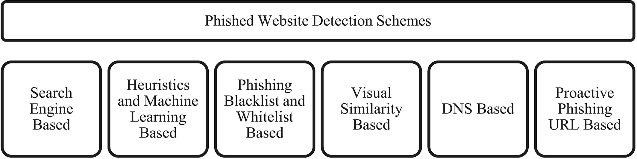
A classification of phished website detection schemes:

Slide 18
(1) Search engine based: Search engine-based techniques extract features such as text, images, and URLs from websites, then search for them using single or multiple search engines and collect the findings. The assumption when detecting a normal website is that it will be among the top search results, as normal websites typically have a higher index than phishing webpages, which remain active for a very short time. (2) Heuristics and machine learning based: These techniques extract a set of features of either text, image, or URL-specific information from normal or abnormal websites. A set of heuristics is utilized, and the thresholds or rules obtained from the learning algorithms are used for anomaly detection. (3) Phishing blacklist and whitelist based: The methods in this category utilize the whitelist of normal websites and the blacklist containing anomalous websites to detect phishing. The blacklist is obtained either by user feedback or via reporting by the third parties who perform phishing URL detection using one of the other phishing detection schemes. (4) Visual similarity based : The technique utilizes the visual similarity between webpages to detect phishing. When phishing web sites are matched in terms of their visual characteristics with the authentic websites, it checks whether the URL is on the authentic domain URL list. If not, the website is marked as a phishing website. (5) DNS based: DNS is used to validate the IP address of a phishing website. For example, DNS will identify whether the IP address over which the phishing website is running is on the list of authentic website IPs. If it is not, the website is marked as phishing. DNS can also be utilized by these techniques in other ways, based on the needs of the user.

Slide 19
(6) Proactive phishing URL detection based : This scheme detects probable phishing URLs by generating different combinatorial URLs from existing authentic URLs and determining whether they exist and are involved in phishing-related activities on the web. Figure 6. A classification of phished website detection schemes. G. Varshney, M. Misra and P. K. Atrey Phishing is a fraudulent act that is used to deceive users Security Comm. Networks (2016) . The identified pros and cons resulting from the study and analysis of the aforementioned schemes are An analysis of these techniques in terms of various parameters such as availability as a client side implementation, real-time phishing attack detection capability, the need for training and updates, computational complexity, storage complexity, and communication cost. Literature review of phishing detection proposals: Latest phishing detection proposals in various categories are as follows: Search engine-based techniques: All SEB techniques extract and use webpage text, images, or URLs as a search string to determine the popularity of a website using search engines to detect phishing. The techniques are different, however, in terms of (i) type and number of features extracted (text, URL, or images) from a webpage; (ii) number of search engines used to determine webpage popularity, (iii) number of top results used for matching; (iv) the underlying decision making algorithm; and (v) additional use of logic from other anti-phishing schemes. A brief description of these schemes is as follows: Varshney et al. focused on the need of lightweight phishing detection approach using search engines.

Slide 20
Authors identified the lightest possible features (page title and domain name) that can be extracted from a webpage without a complete webpage loading. Based on this, authors developed an intelligent anti-phishing chrome extension named lightweight phish detector (LPD). LPD not only detects but also suggests the authentic webpage to the user when a user reaches a deceptive or phishing page on the browser. Ramesh et al. proposed a technique that collects and matches a group of domains having direct and indirect association with the domain of the suspicious webpage to detect phishing. Jun et al. [38] proposed a scheme wherein the URL of a website is searched using popular search engines such as Google, Bing, and Yahoo. The number of search results obtained and their rankings are then used for classification. Hung et al. [50] proposed an approach that captures a screenshot of the webpage and extracts the website logo, which is then searched using Google image search. The returned keywords are then fed to Google text search, and if current domain name does not match any of the top 30 domain names returned in the search results, then the website is identified as phishing.

Slide 21
THE END

